Slide 1
Machine Learning
A Practical Introduction

Slide 2
Agenda
Practical examples of ML
Supervise vs unsupervised learning
ML process
Example using python
Unsupervised (part1)
Supervised (part 2)

Slide 3
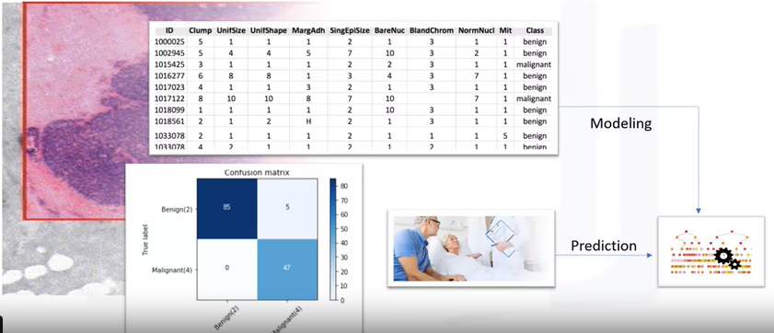
Example
Two class:
Benign or malignant
https://www.coursera.org/learn/machine-learning-with-python/lecture/zSm8k/introduction-to-machine-learning
Performance measures

Slide 4
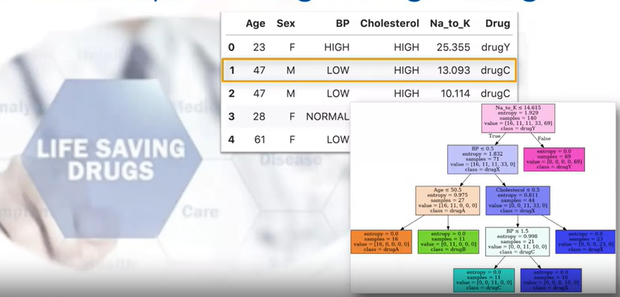
Practical examples of ML Such as predicting the rigth drug
https://www.coursera.org/learn/machine-learning-with-python/lecture/zSm8k/introduction-to-machine-learning

Slide 5
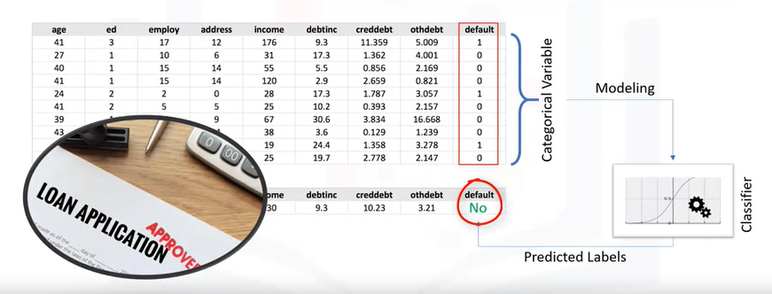
Practical examples of ML To make decision
https://www.coursera.org/learn/machine-learning-with-python/lecture/zSm8k/introduction-to-machine-learning

Slide 6
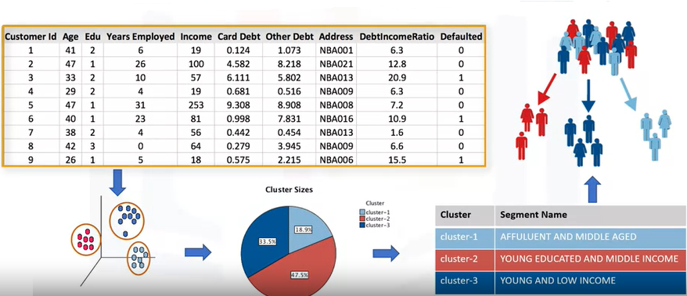
Practical examples of ML To customer segmentation
https://www.coursera.org/learn/machine-learning-with-python/lecture/zSm8k/introduction-to-machine-learning

Slide 7
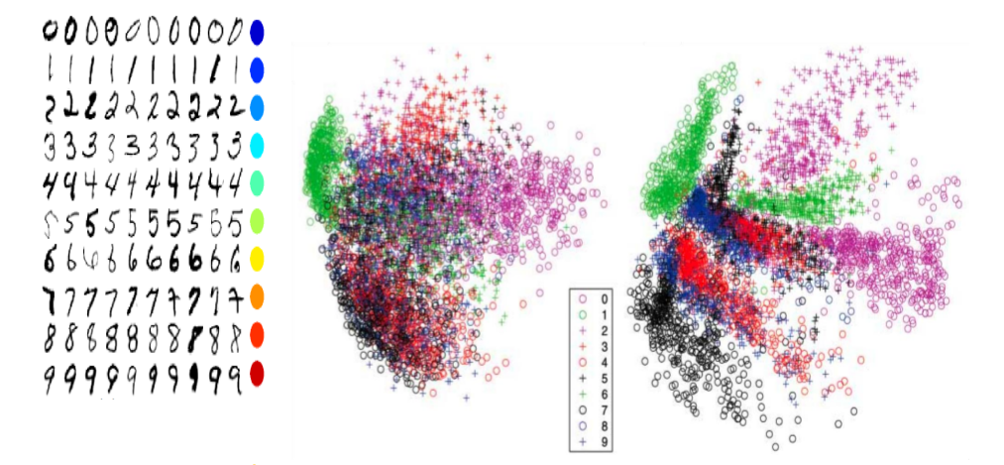
Practical examples of ML To dimensionality reduction:

Slide 8
Supervise vs unsupervised learning
Supervise
Classification:
Classifies label data
Regression:
Predict trends using previous labeled data
Controlled environment
Unsupervised
Clustering:
Find patterns and grouping from unlabeled data
Dimensionality reduction:
Less controlled environment

Slide 9
Supervise vs unsupervised learning
Supervise
Unsupervised

Slide 10
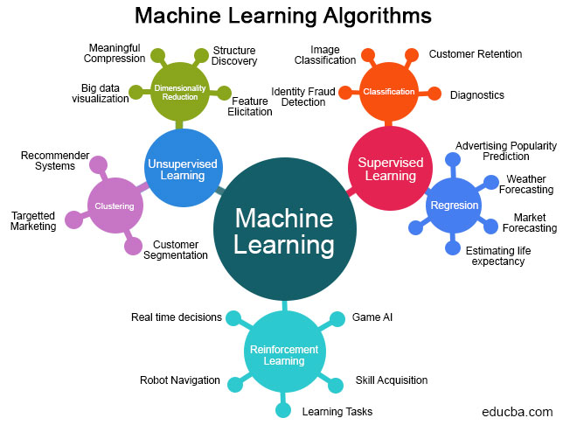

Slide 11
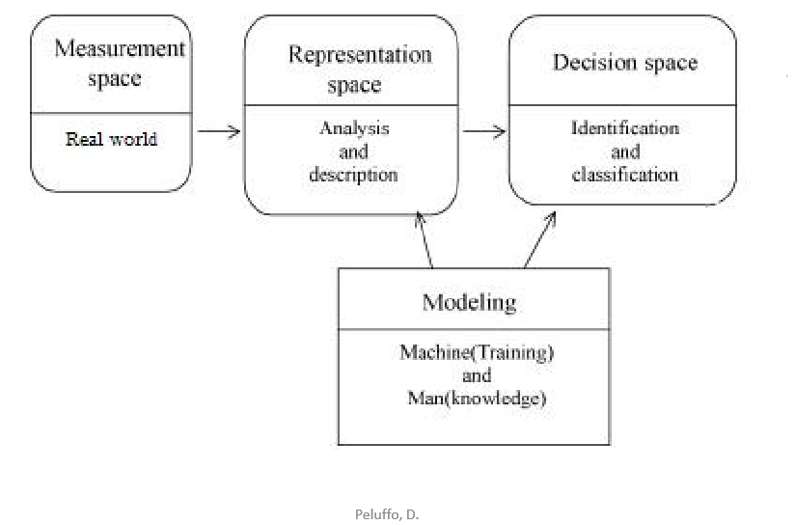
Machine learning process
Acquired
Prepare
Analyze
Deploy model

Slide 12
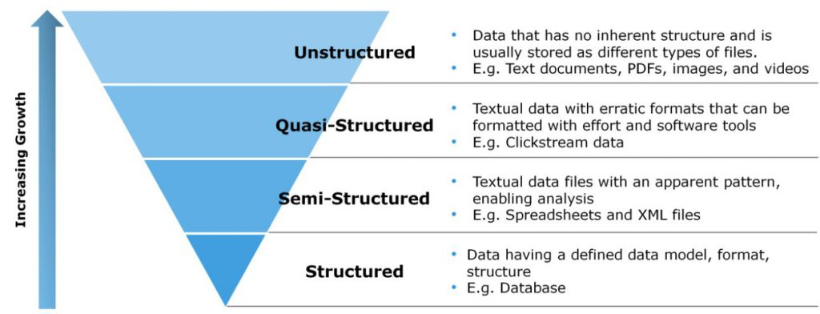
Acquired
Step 1:Acquired
Identify data source
Collect data
Integrate data
https://www.mycloudwiki.com/wp-content/uploads/2016/06/1-1-1024x392.jpg
Notes:
Los Datos pueden venir en una gran variedad de formas, desde datos financieros altamente estructurados hasta datos en textos o archivos multimedia. Existen diferentes tipos de datos, las dos grandes categorías en las que se dividen son los datos cualitativos, y los datos cuantitativos
Datos cualitativos: Son todos aquellos que contestan la pregunta “¿Cuál?” (o “¿Cuáles?”), son etiquetas y se dividen en nominales (no se pueden ordenar) y ordinales (se pueden ordenar).
Datos cuantitativos: Son los datos que se refieren a números.

Slide 13
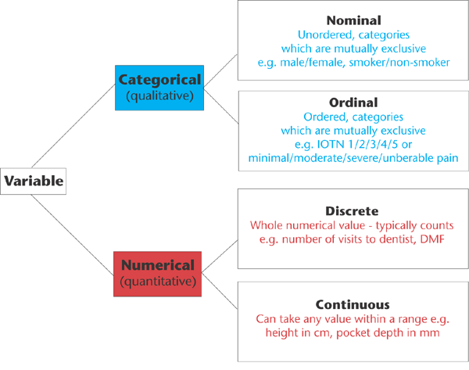
Acquired
Prepare
Understand nature of data
Step 2:Prepare
Explore data
Preprocess
https://www.nature.com/articles/6400501/figures/1

Slide 14
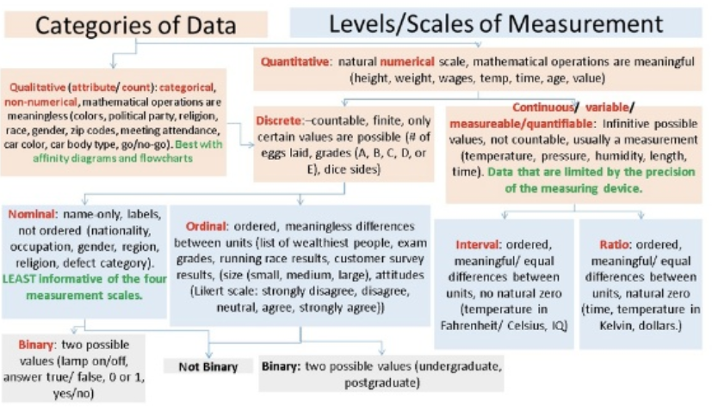
Acquired
Prepare
https://www.slideshare.net/josefslerka/the-nature-of-data

Slide 15
Acquired
Prepare
Explore data.
Understand nature of data
 | Level of measurement
Type of descriptive statistic | Nominal | Ordinal | Interval | Ratio
Mode, counts, frecuency | Yes | Yes | Yes | Yes
Median, minimum, maximum, range | No | Yes | Yes | Yes
Mean, variance, Standar desviation | No | No | Yes | Yes

Slide 16
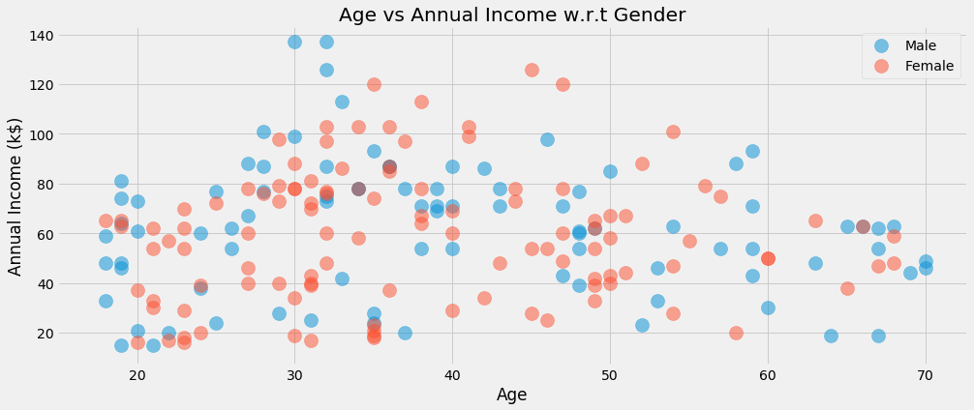
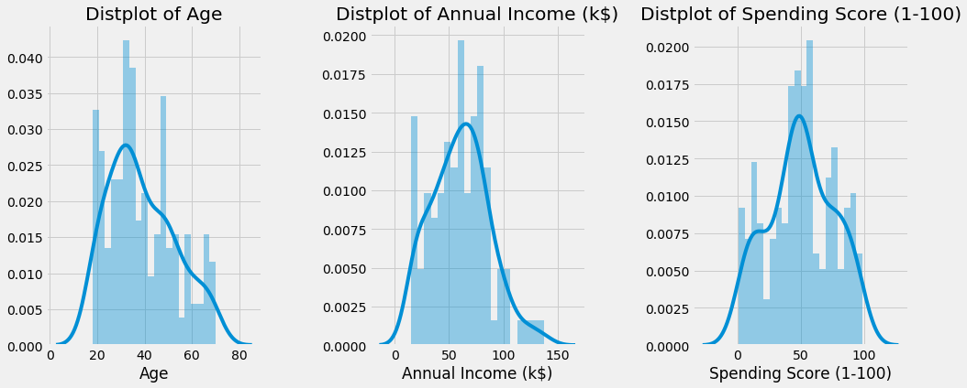
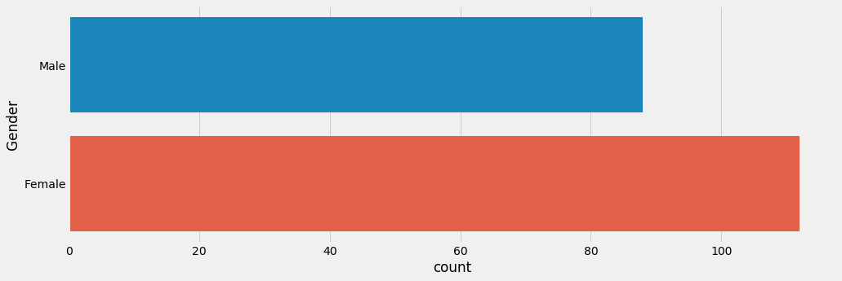
Acquired
Prepare
Explore data.
The goals:
Detection of data errors
Checking of assumptions
Finding hidden patterns (such as tendency)
Preliminary selection of appropriate models
Determining relationships between the variables

Slide 17
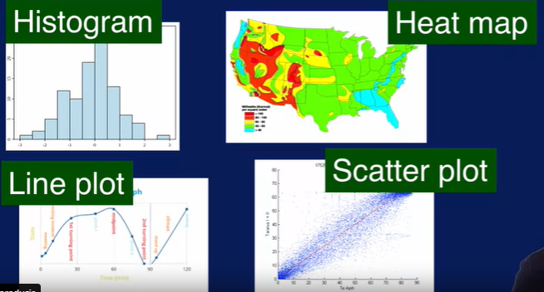
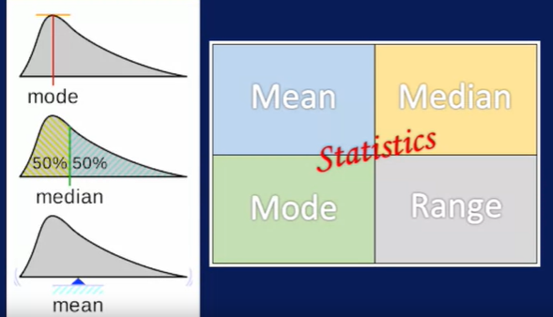
Acquired
Prepare
Explore data.

Slide 18
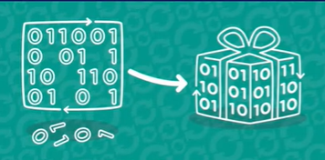
Acquired
Prepare
Step 2:prepare
Explore data
Preprocess
clean
select
transform

Slide 19
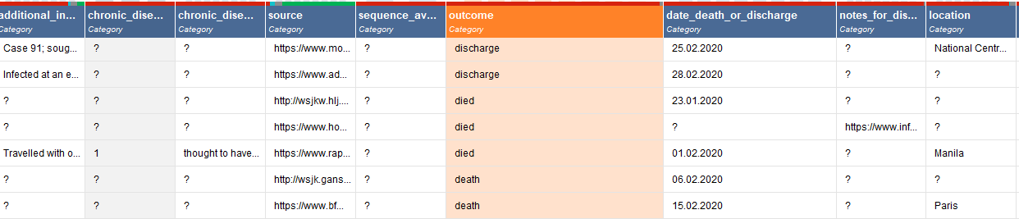
Acquired
Prepare
Explore data Preprocess
Missing values
Duplicate Data
Inconsistent data
Noise
Outliers
clean
Missing values
Same labels

Slide 20
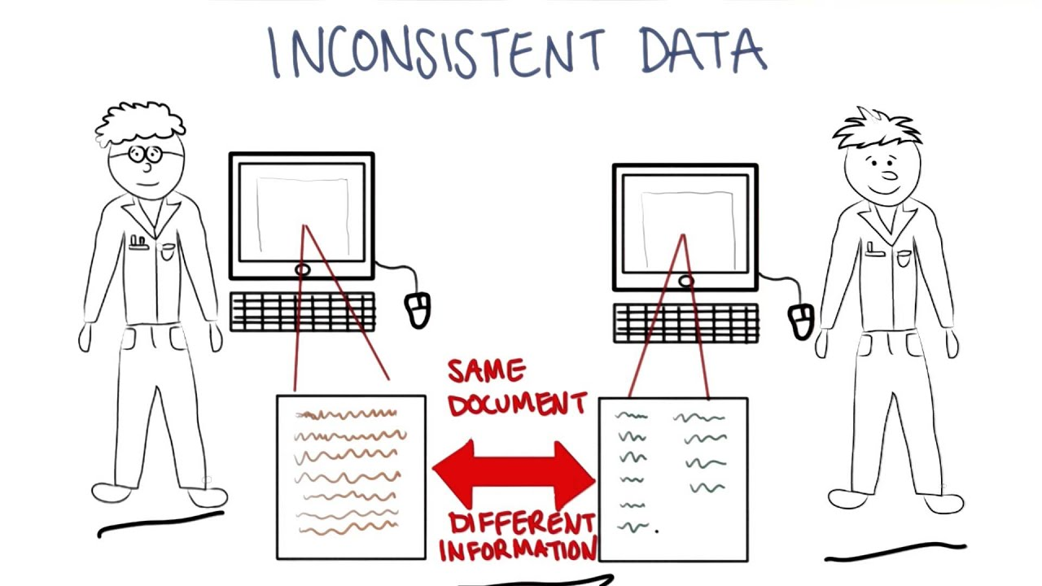
Acquired
Prepare
Missing values
Duplicate Data
Inconsistent data
Noise
Outliers

Slide 21
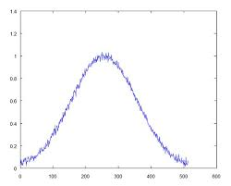
Acquired
Prepare
Missing values
Duplicate Data
Inconsistent data
Noise
Outliers

Slide 22
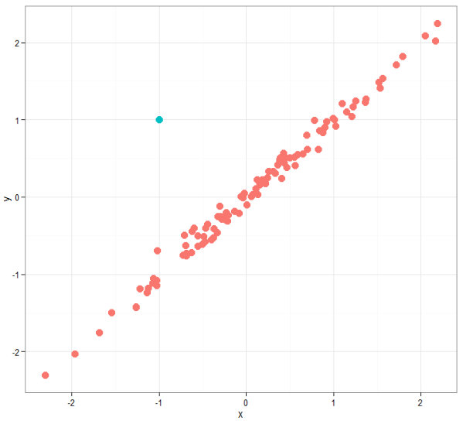
Acquired
Prepare
Missing values
Duplicate Data
Inconsistent data
Noise
Outliers
Outlier

Slide 23
Acquired
Prepare
Explore data Preprocess
clean
select
Balanced or
imbalance data
Delete features
Combine features
Add feature

Slide 24
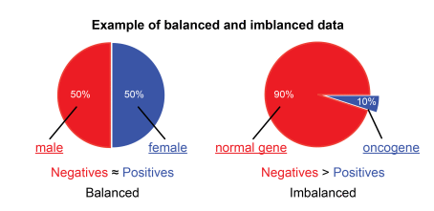
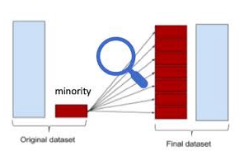
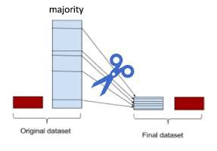
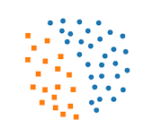
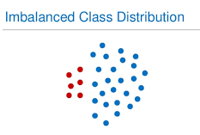
Acquired
Prepare
Explore data Preprocess
Balanced or
imbalance data
clean
select
https://medium.com/analytics-vidhya/what-is-balance-and-imbalance-dataset-89e8d7f46bc5

Slide 25
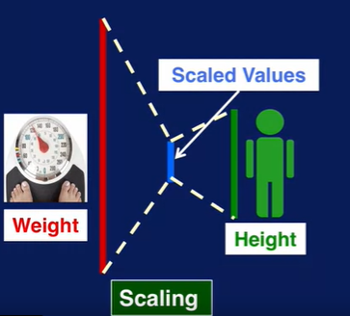
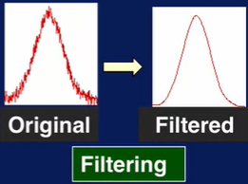
Acquired
Prepare
Explore data Preprocess
clean
Select
Transform
Scaling
Filtering
others

Slide 26
Acquired
Prepare
Analyze
ML technique
evaluated
Confusion Matrix
F1 Score
ROC curve
Root Mean Squared Error
What is a Cross Validation?
Clustering
Regression
Classification
Dimensionality reduction

Slide 27
Acquired
Prepare
Analyze
Action
Report
Determinate action
iterative
implement
Communicate results
What to do if we get negative results in research?
The important thing to do is to document all, negative result, explanation on possible reasons why not getting the positive results after further literature review. As what Thomas Edison said "I have not failed 700 times, I have not failed once. I have succeeded in proving that those 700 ways will not work. When I have eliminated the ways that will not work, I will find the way that will work". You need passion and perseverance.

Slide 28
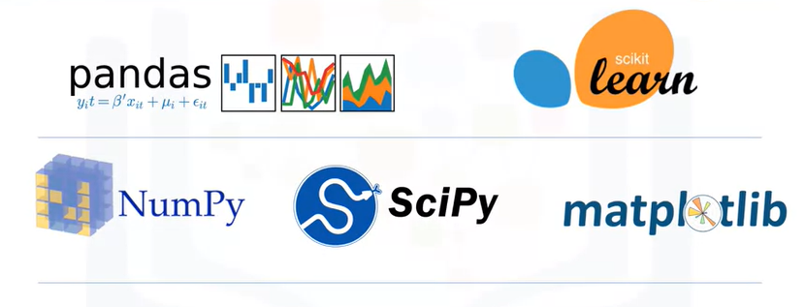
Practical example with python
Python libraries to machine learning

Slide 29


We will use to libraries and you can set up the libraries to work in online or offline mode, or in jupyter notebooks. I will use spyder.
pip install plotly==4.5.2
pip install -U scikit-learn
conda install -c plotly plotly=4.5.2
conda install scikit-learn

Slide 30
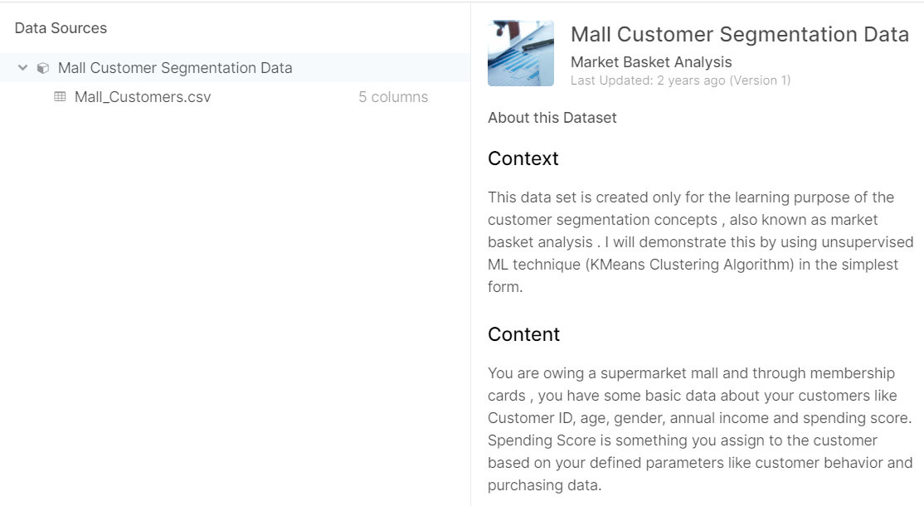
Acquired
Prepare
Analyze
Action
From Udemy's Machine Learning A-Z course.
https://github.com/SteffiPeTaffy/machineLearningAZ/blob/master/Machine%20Learning%20A-Z%20Template%20Folder/Part%204%20-%20Clustering/Section%2025%20-%20Hierarchical%20Clustering/Mall_Customers.csv

Slide 31
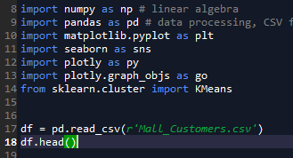
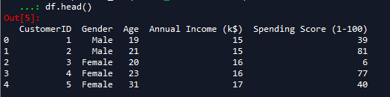
Acquired
Prepare
Analyze
Action
Step 1:Acquired

Slide 32
Acquired
Prepare
Analyze
Action
Step 2:Prepare
?
?
?

Slide 33
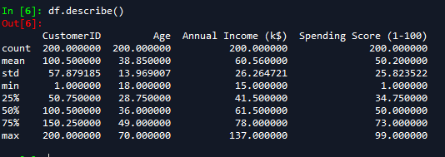
Acquired
Prepare
Analyze
Action
Step 2:Prepare

Slide 34
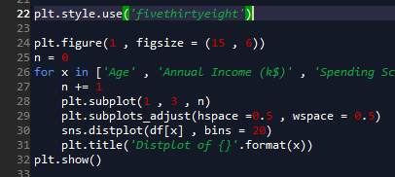
Acquired
Prepare
Analyze
Action

Slide 35
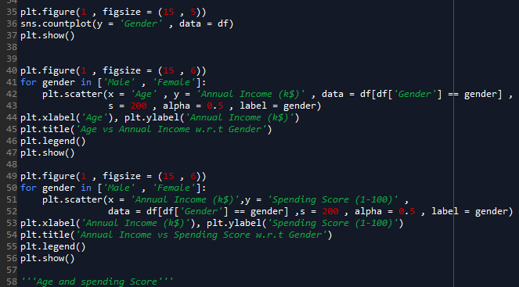
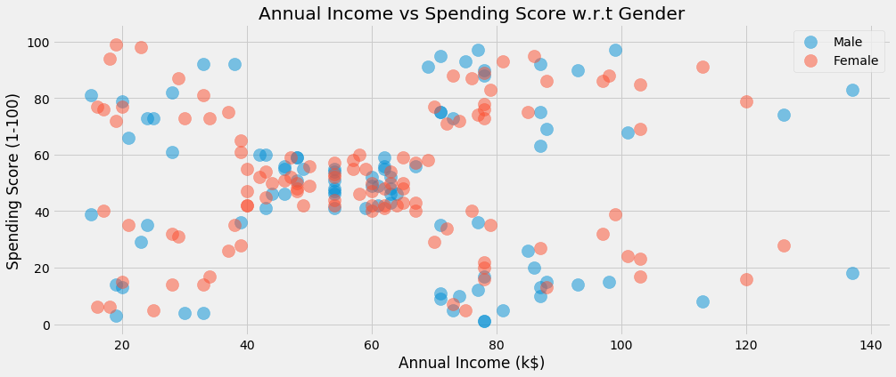
Acquired
Prepare
Analyze
Action
35

Slide 36
Acquired
Prepare
Analyze
Action
Checking of assumptions
Finding hidden patterns (such as tendency)
Determining relationships between the variables

Slide 37
Acquired
Prepare
Analyze
Action
ML technique
Clustering
Regression
Classification
Dimensionality reduction

Slide 38
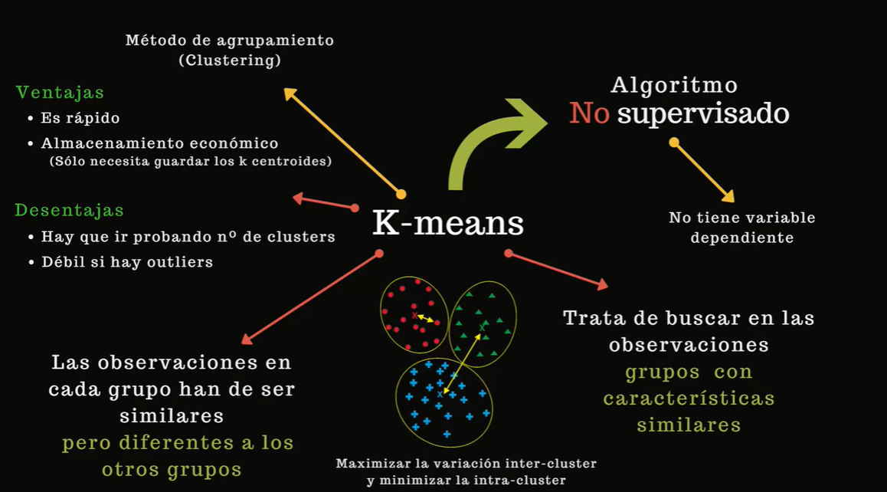
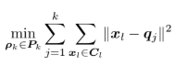
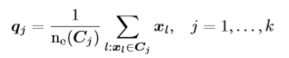
Acquired
Prepare
Analyze
Action
Clustering

Slide 39
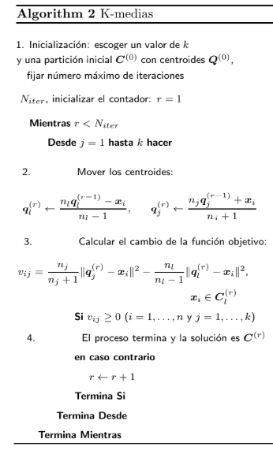


Slide 40
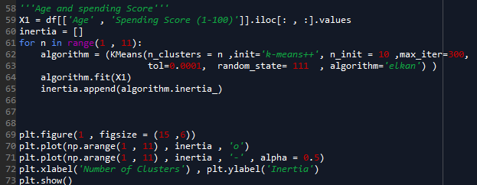
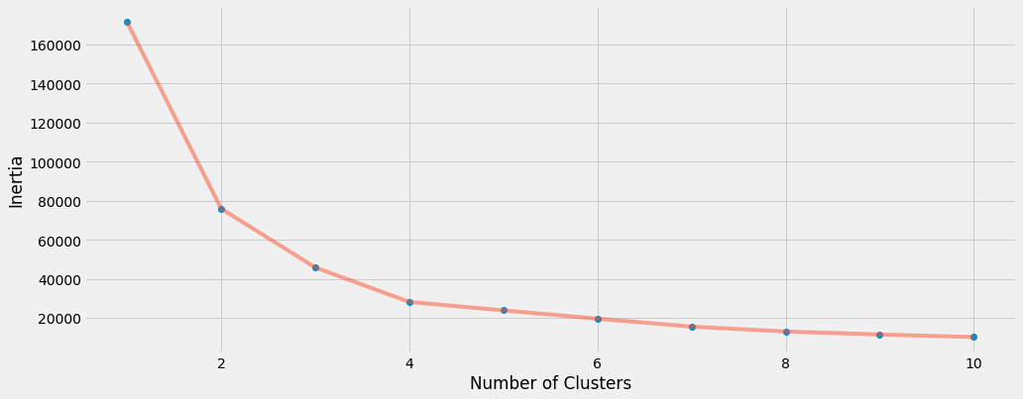
Acquired
Prepare
Analyze
Action
How to Determine the Optimal K for K-Means
The Elbow Method
This is probably the most well-known method for determining the optimal number of clusters. It is also a bit naive in its approach.
Calculate the Within-Cluster-Sum of Squared Errors (WSS) for different values of k, and choose the k for which WSS becomes first starts to diminish. In the plot of WSS-versus-k, this is visible as an elbow.

Slide 41
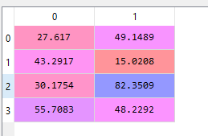
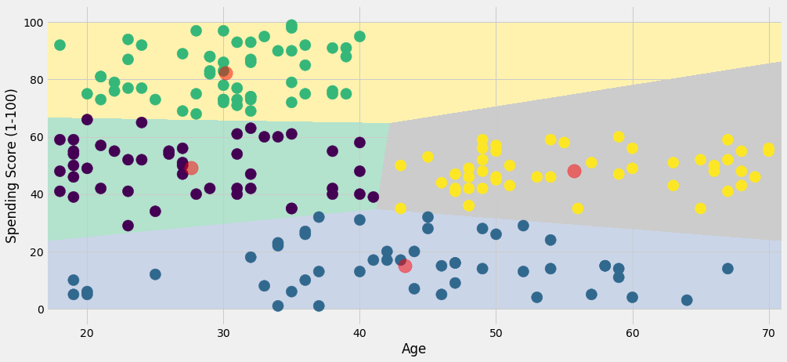
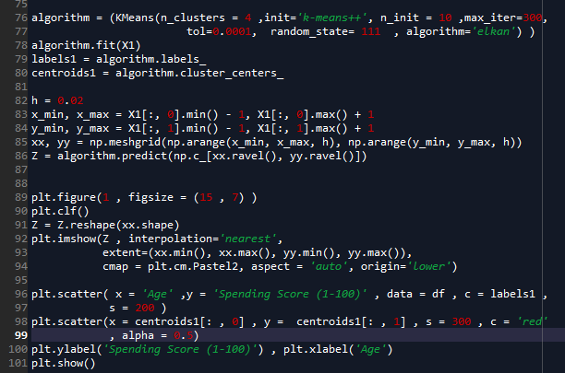
Acquired
Prepare
Analyze
Action
3
4
1
2

Slide 42
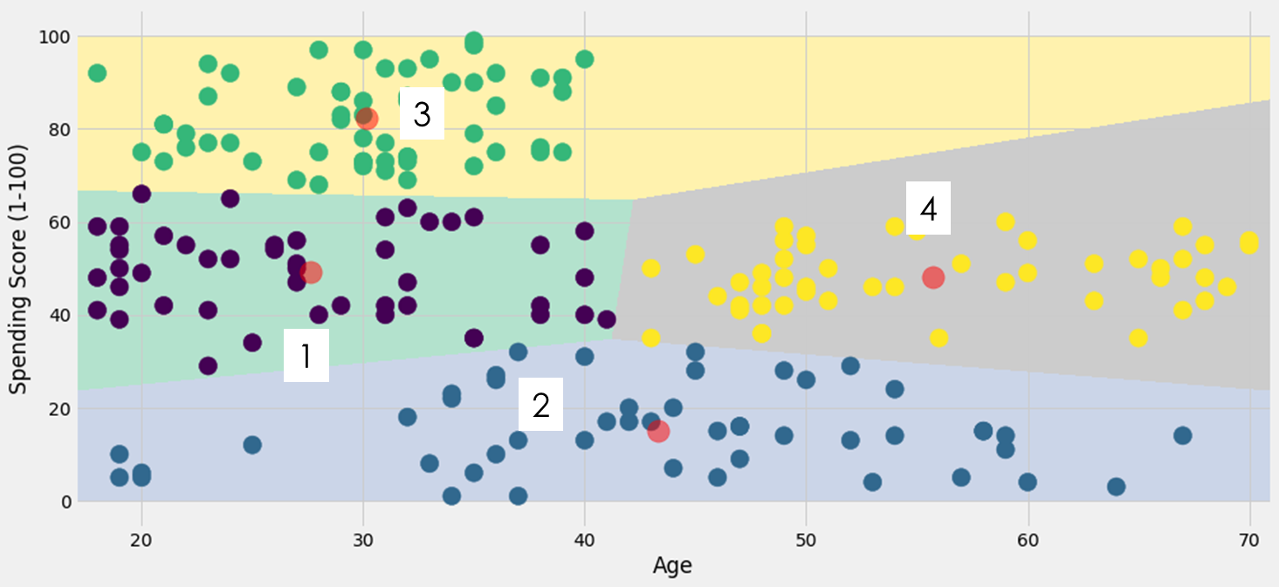
Acquired
Prepare
Analyze
Action
On a general level, we may conclude that most of the Customers have their Spending Score in the range of 35-60.
(red line)
People at Age 32 are the Most Frequent Visitors in the Mall.
by looking at the above clustering plot between the age we can split in 4 different categories:
Namely Usual Customers, (2)
Priority Customers, (3)
Senior Citizen Target Customers, (4)
Young Target Customers. (1)
Then after getting the results we can accordingly make different marketing strategies and policies to optimize the spending scores of the customer in the Mall.

Slide 43
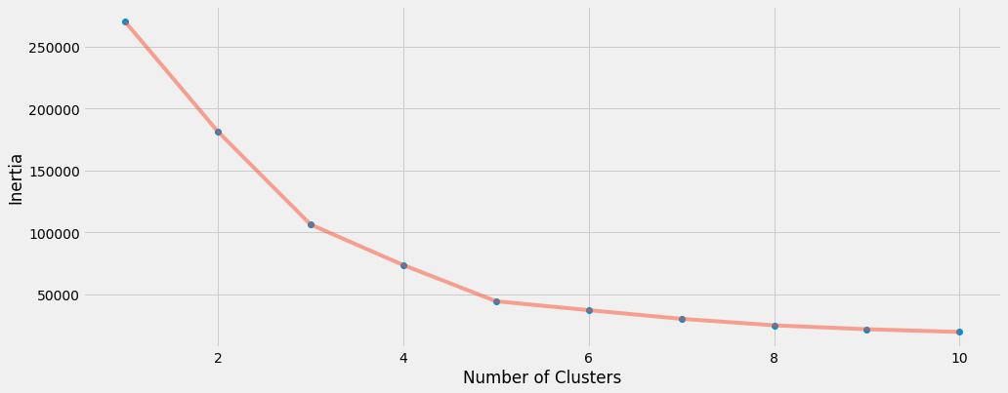
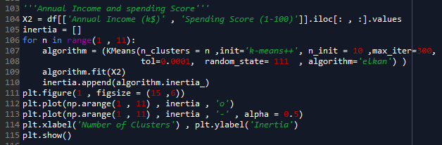
Acquired
Prepare
Analyze
Action

Slide 44
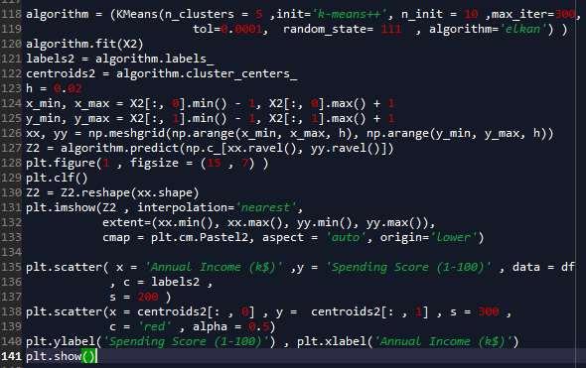
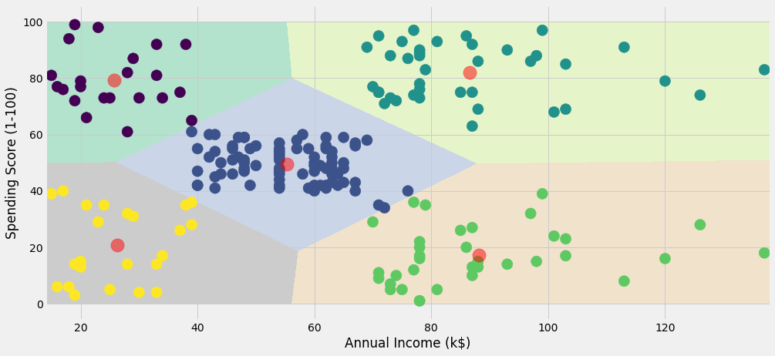
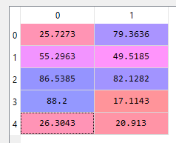
Acquired
Prepare
Analyze
Action
1
3
2
5
4

Slide 45

This Clustering Analysis gives us a very clear insight about the different segments of the customers in the Mall. There are clearly Five segments of Customers.
A person who makes little and spends a lot (1) reckless no se puede prestar, fiar A person who makes little and spends little (5) thrifty customer ofrecer promociones A person who makes the average and spends the average (2) Normal customer A person who makes a lot and spends a lot (3) Premium customer fiar A person who makes a lot and spends little (5) Potential customer buscar gustos para que gaste

Slide 46
Acquired
Prepare
Analyze
Action
Having a better understanding of the customers segments, a company could make better and more informed decisions.
An example, there are customers with high annual income but low spending score. A more strategic and targeted marketing approach could lift their interest and make them become higher spenders.
The focus should also be on the "loyal" customers and maintain their satisfaction and increase the good customer.

Slide 47



Slide 48


Slide 49

https://towardsdatascience.com/the-5-clustering-algorithms-data-scientists-need-to-know-a36d136ef68

Slide 50


Slide 51

PCA: Principal Component Analysis
What is PCA?
PCA is a statistical technique to extract patterns in a dataset
PCA is the best known and used to reduce the dimensions of dataset

Slide 52
Why do we need to reduce the dimensions in dataset? Isn’t that loosing information?
Yes, we loose information when we discard some of the dimensions in our data.
However, in some cases our data can have lots of features or variables to apply a machine learning technique to do classification or clustering. Think about user dataset of AmazonVideo, Youtube or Netflix, they can be in million-dimension where each video content is a variable or feature, and multiply it with the number of users they have when you need to extract similarities between users or videos and produce recommendations.

Slide 53



